Slide 1

Canadian Bioinformatics Workshops
www.bioinformatics.ca
bioinformaticsdotca.github.io

Slide 2
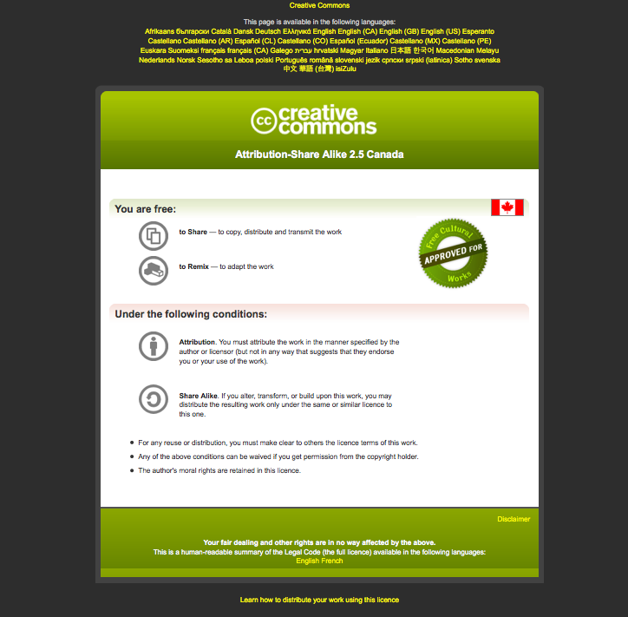

Slide 3


Module Title

Slide 4
Learning Objectives
By the end of this lecture, you will:
Register your AWS Educate Starter account
Launch your AWS instance
Log into your AWS instance

Slide 5
AWS Educate Starter Account
You should have finished this already!
1

Slide 6
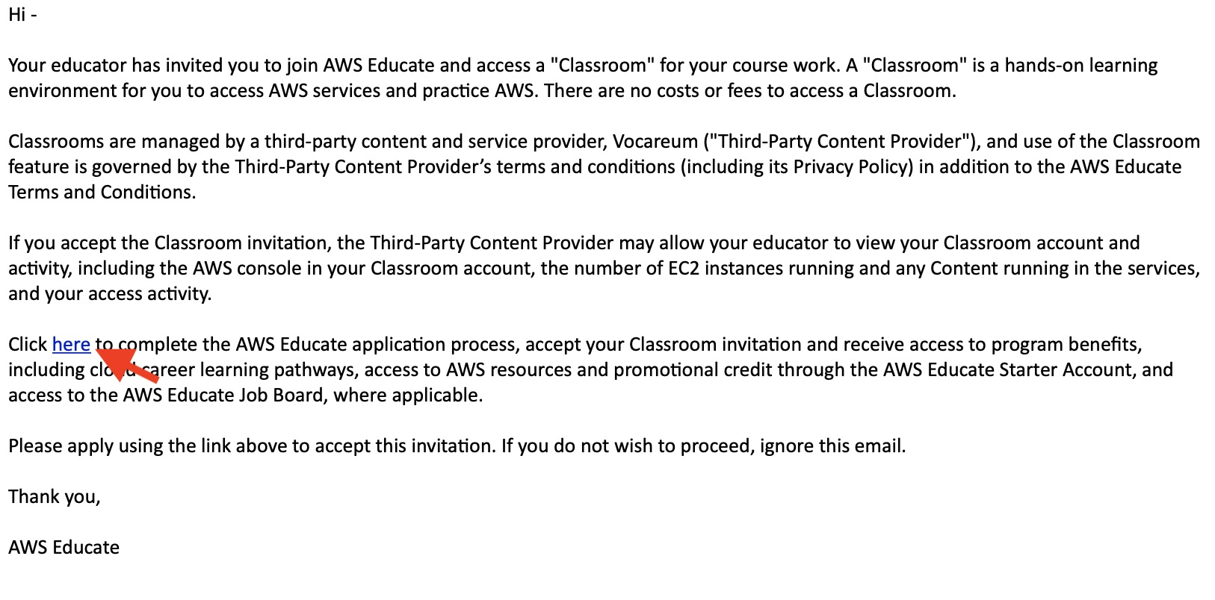
Click the link to register
1

Slide 7
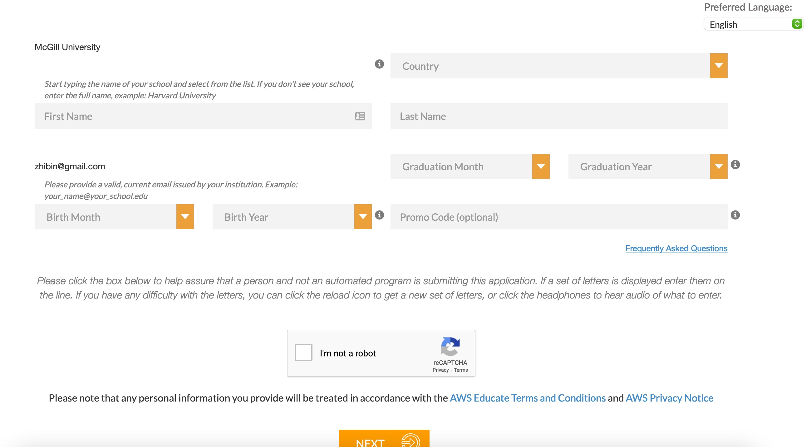
Fill in your information
1

Slide 8
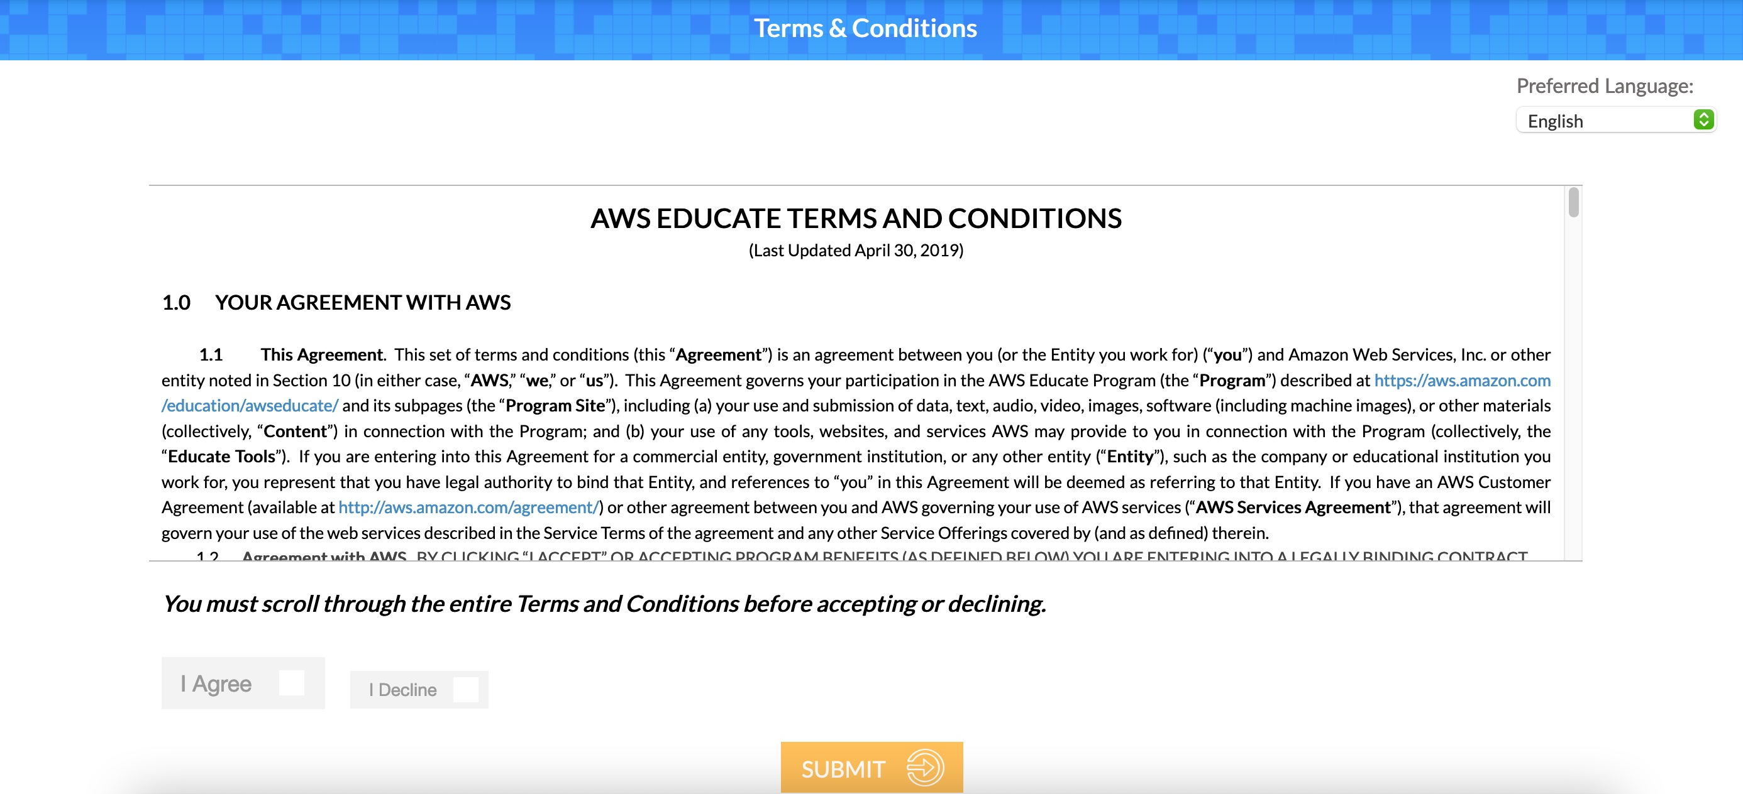
agree to the “Terms and Conditions”
1

Slide 9
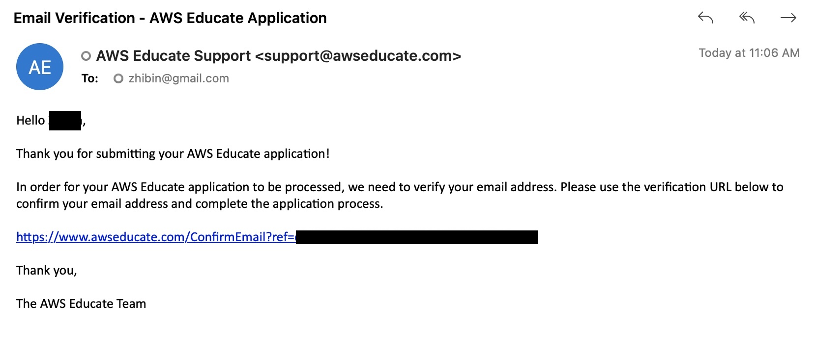
Click the link to verify your email address
1

Slide 10
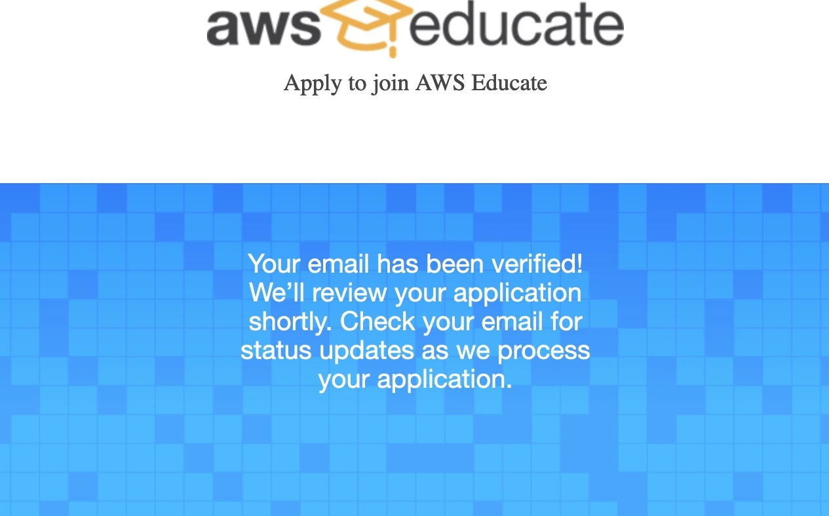
1

Slide 11
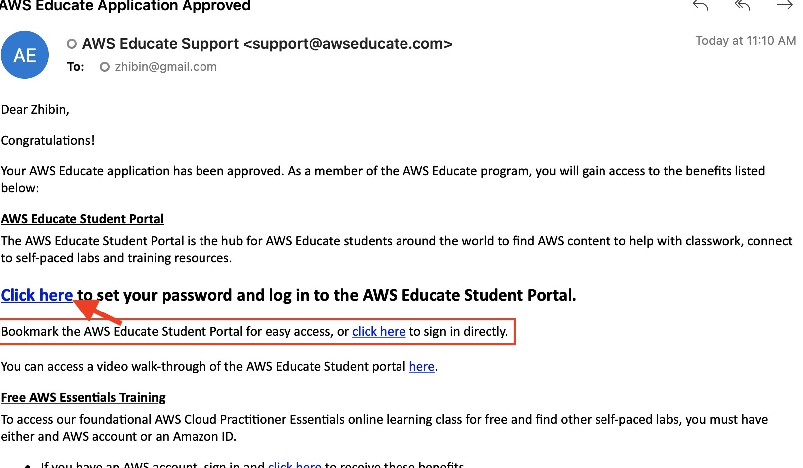
Click the link to set your password
1

Slide 12
Click “AWS Account” after you log in
1

Slide 13
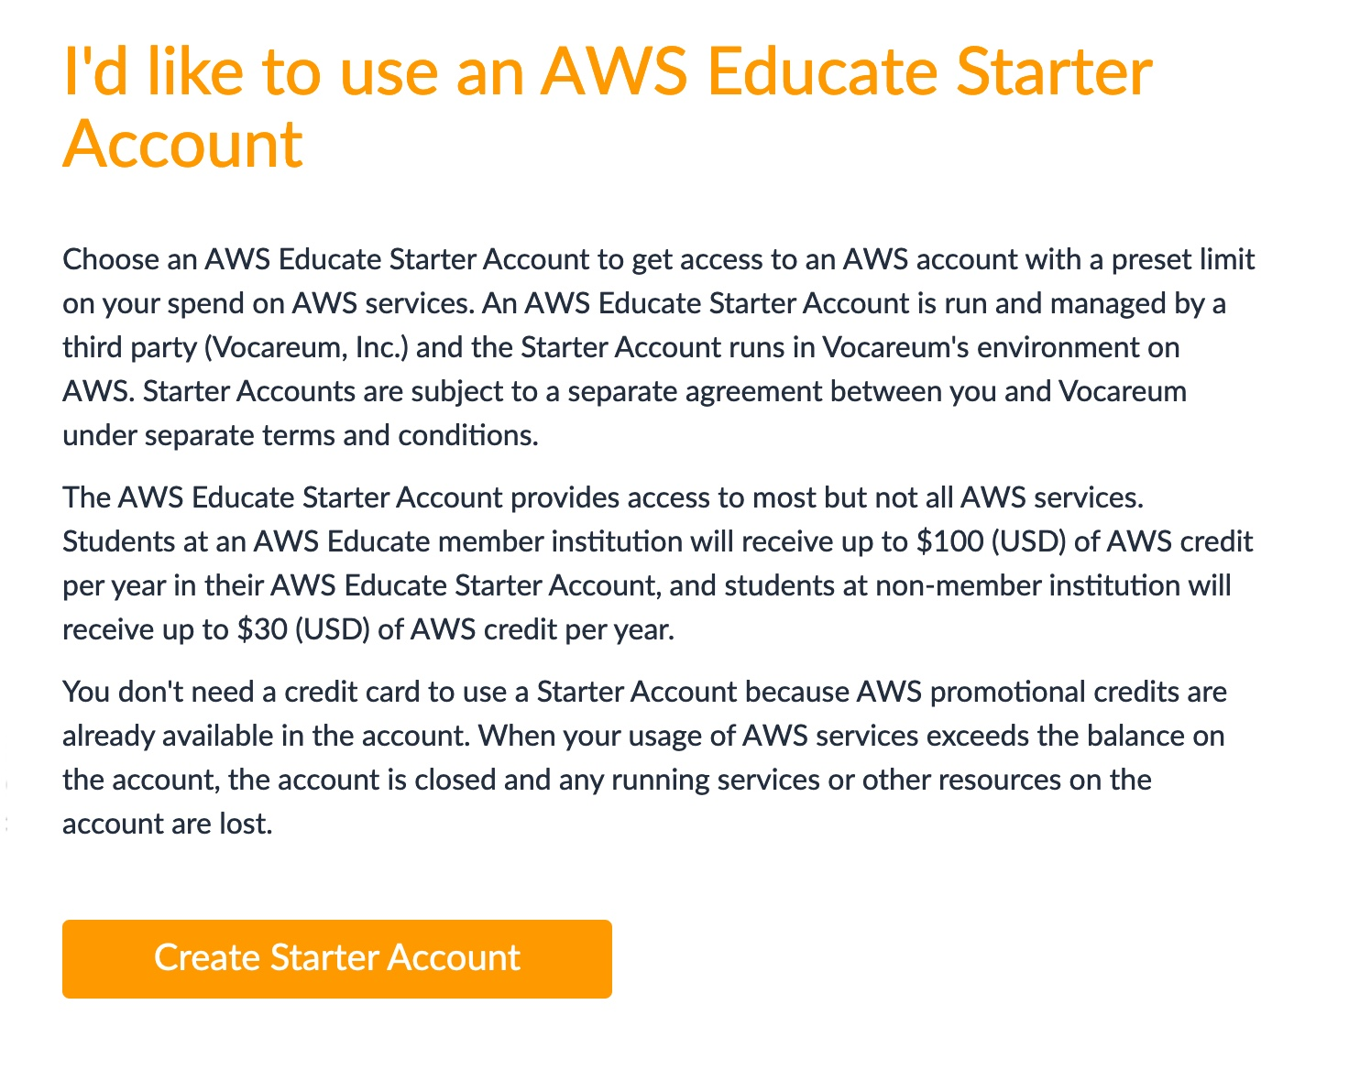
Create your Educate Starter Account
1

Slide 14
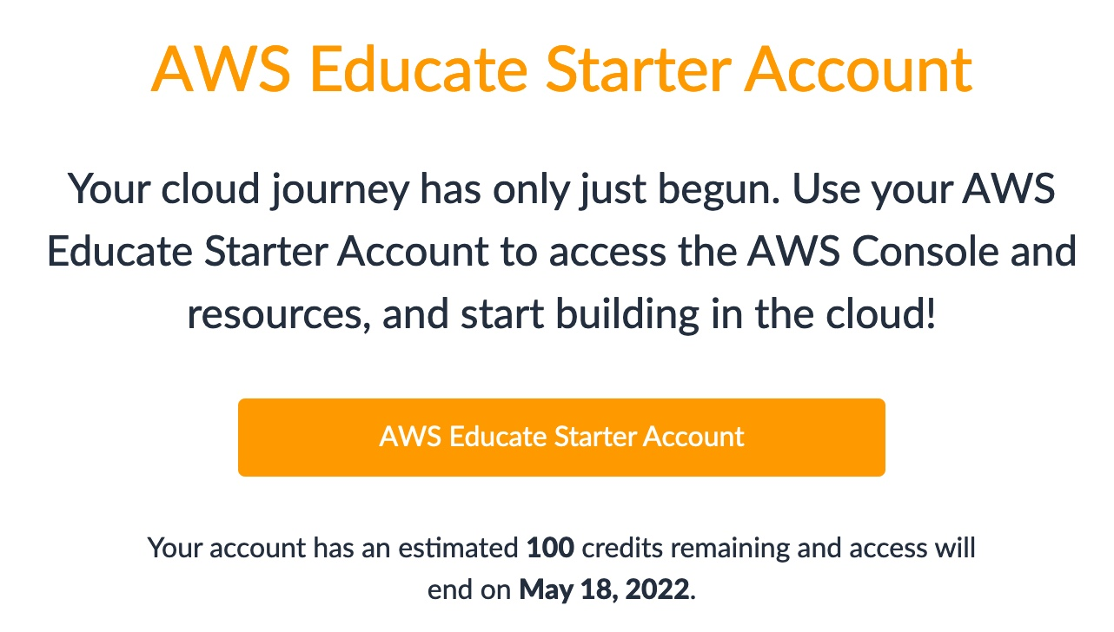
1

Slide 15
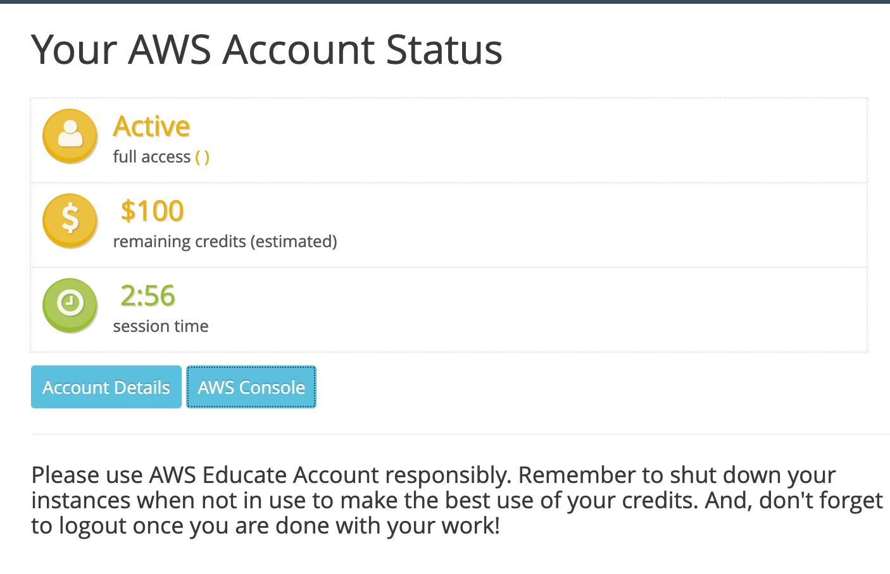
AWS Educate Starter Account
1

Slide 16
Launch AWS EC2 Instance
AWS Educate Starter account
URL: https://aws.amazon.com/education/awseducate/
1

Slide 17
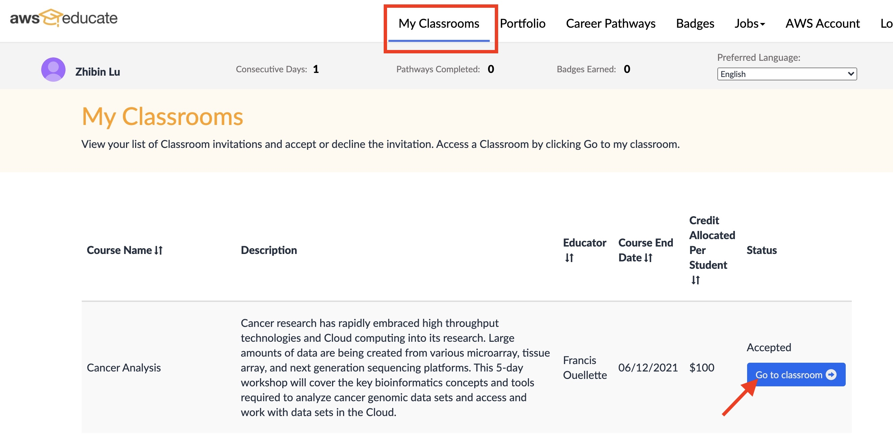
Go to the classroom
1

Slide 18
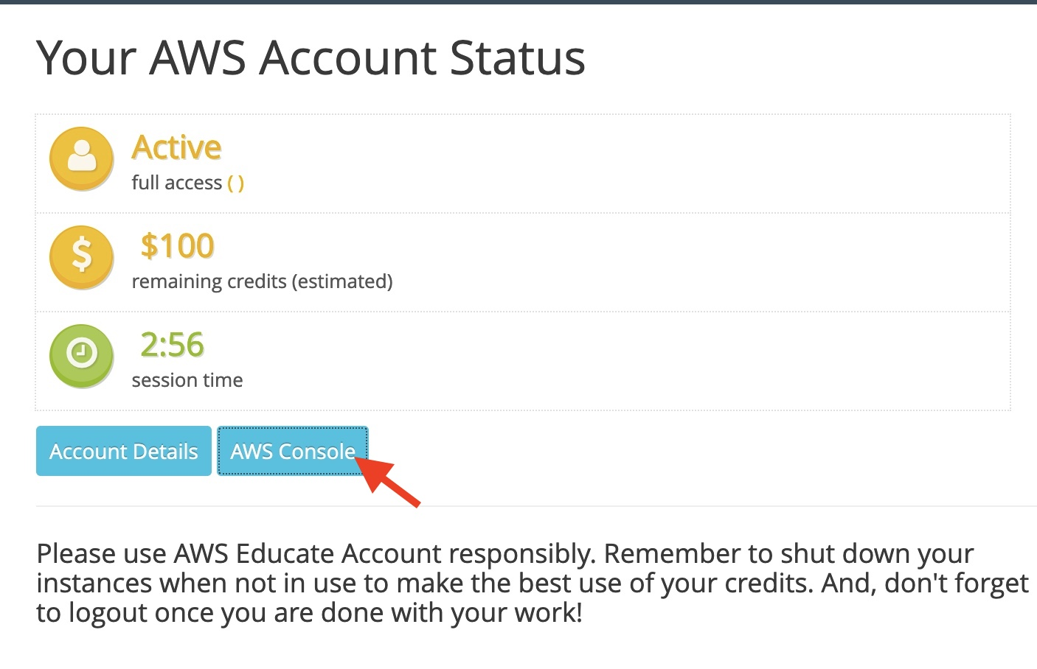
Go to AWS Console

Slide 19
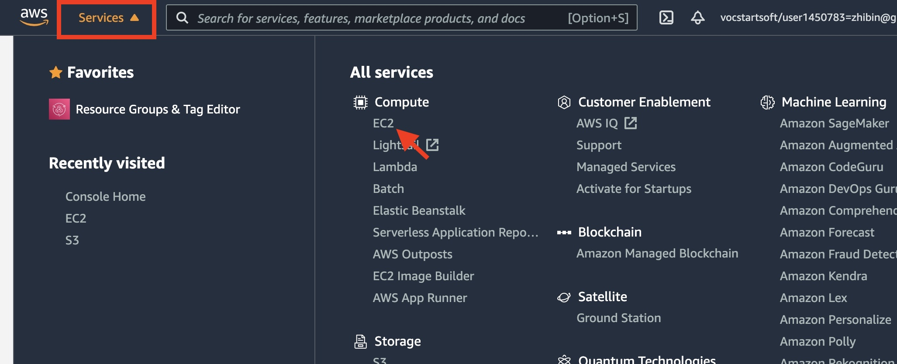
Access EC2 service

Slide 20
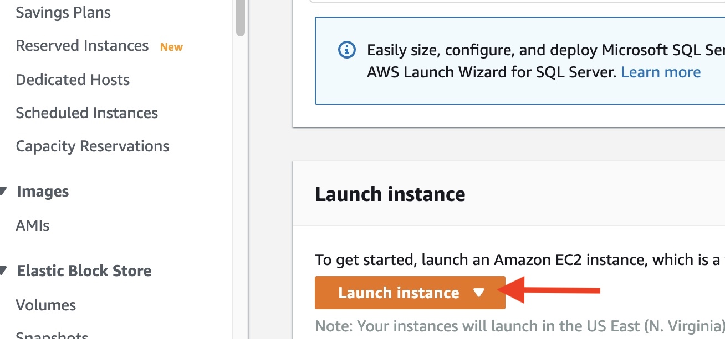
Launch an AWS EC2 Instance

Slide 21
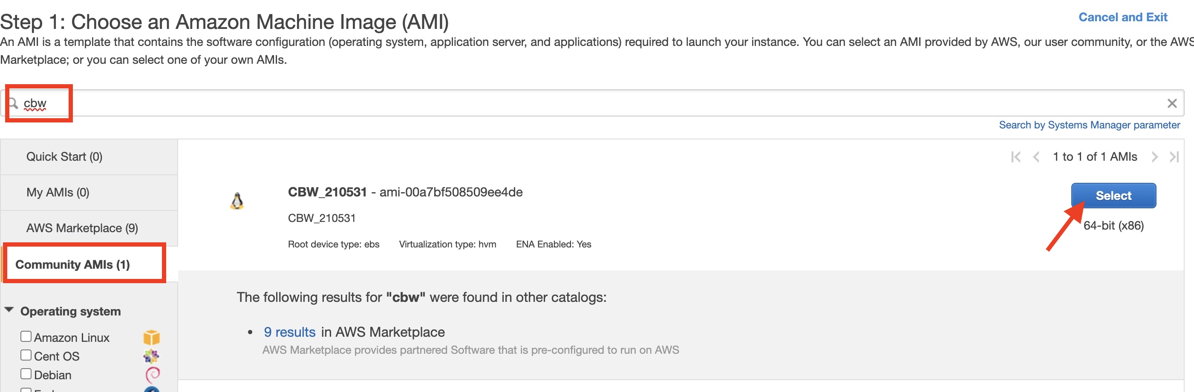
Click “Community AMI” and type “CBW” to search and then Select the correct AMI

Slide 22
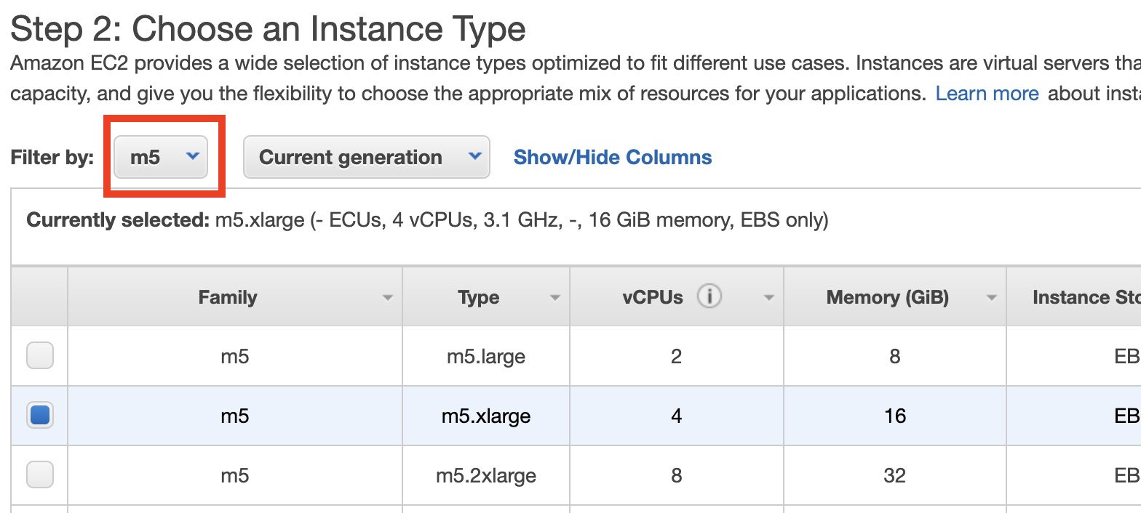
Find m5 types and check m5.xlarge

Slide 23
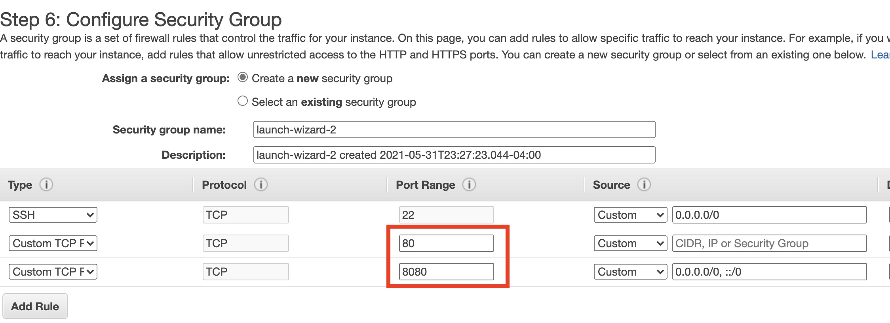
Select an existing security group if you launched instances before, otherwise create a new one. Make sure add rules to allow port 80 and 8080

Slide 24
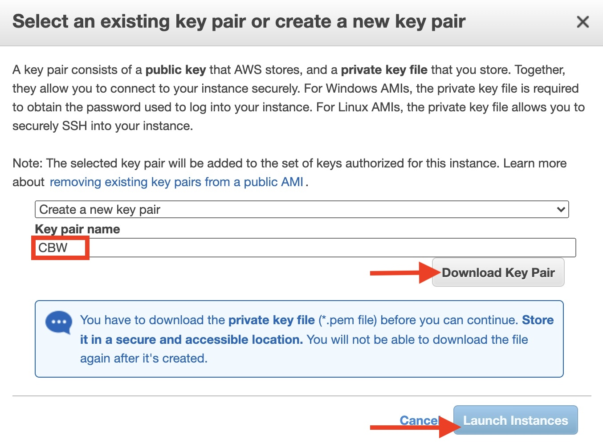
You can use the existing key or create a new key. IMPORTANT! Make sure you download the key and save to a place you can find.

Slide 25
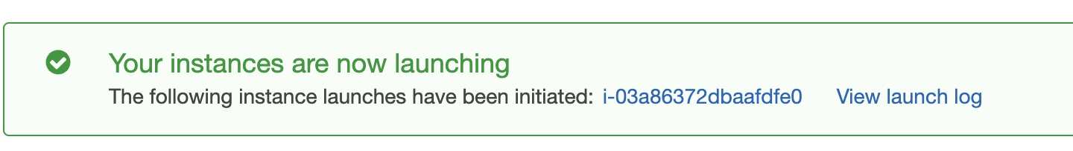

Click “View Instances” to see the instance

Slide 26
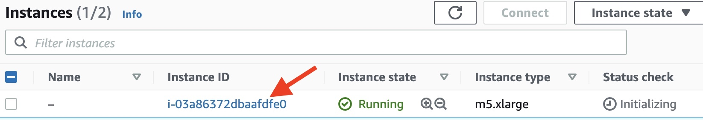
Click the Instance ID to see the details of the instance

Slide 27
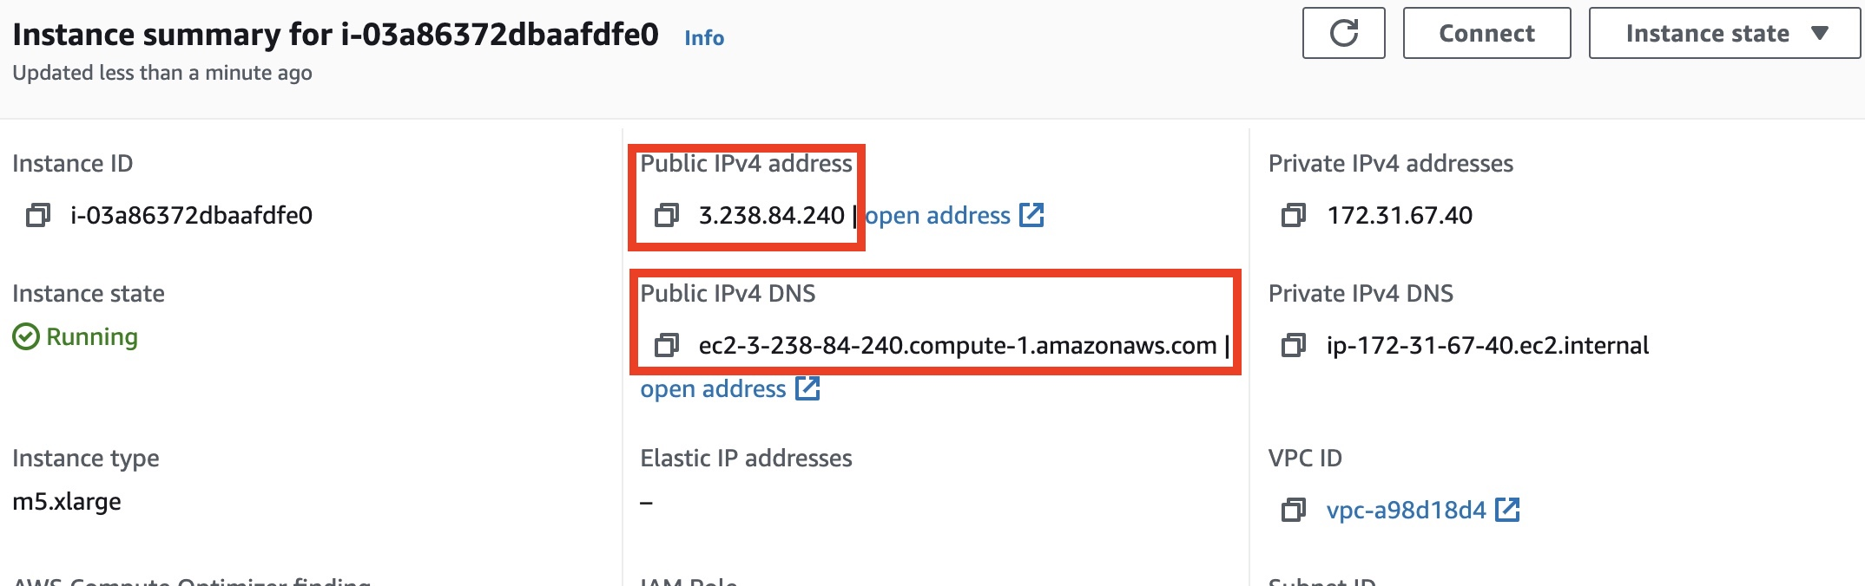
You will need the IPv4 or IPv4 DNS to log into the instance

Slide 28
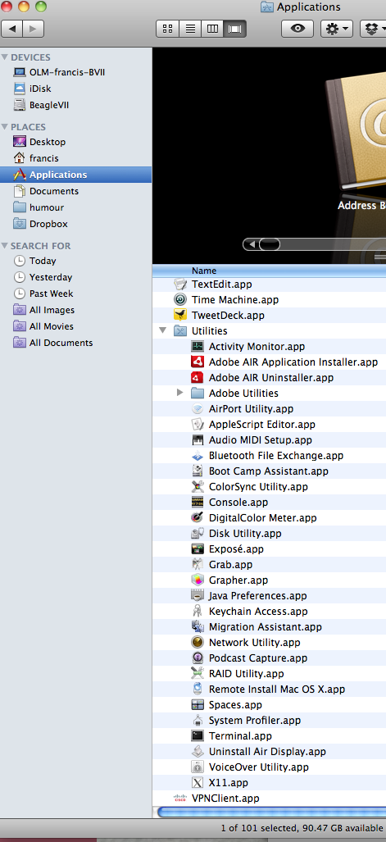
Log into AWS Instance
Mac/Linux: terminal

Slide 29
Mac/Linux
cd Downloads
chmod 600 CBW.pem
ssh -i CBW.pem ubuntu@<public IPv4 or public IPv4 DNS>
Awnser “yes” when you ask if you want to continue connecting

Slide 30
Windows
Download putty.ext and puttygen.exe
URL: https://www.chiark.greenend.org.uk/~sgtatham/putty/latest.html

Slide 31
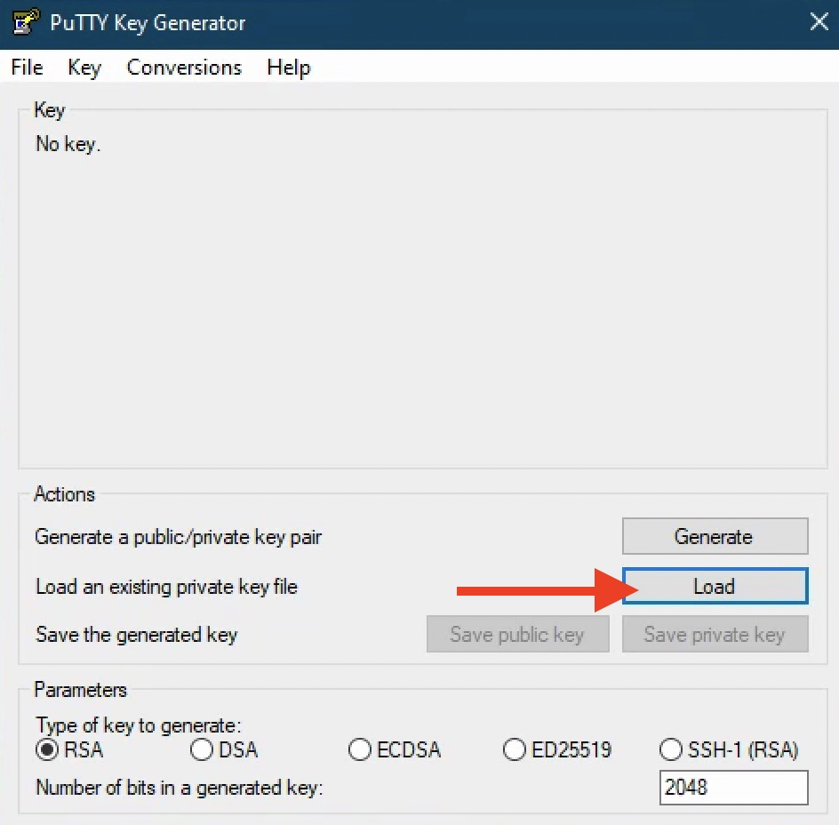
Convert pem to ppk

Slide 32
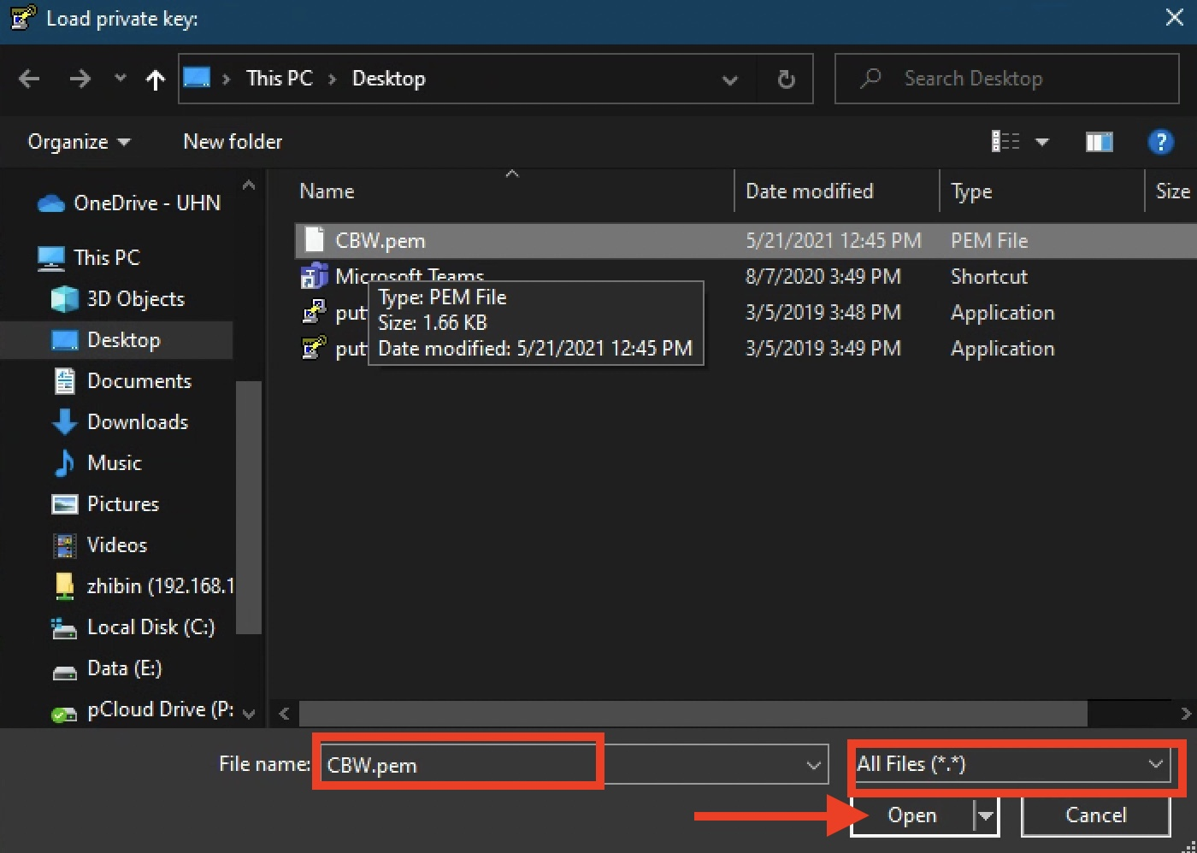
Convert pem to ppk

Slide 33
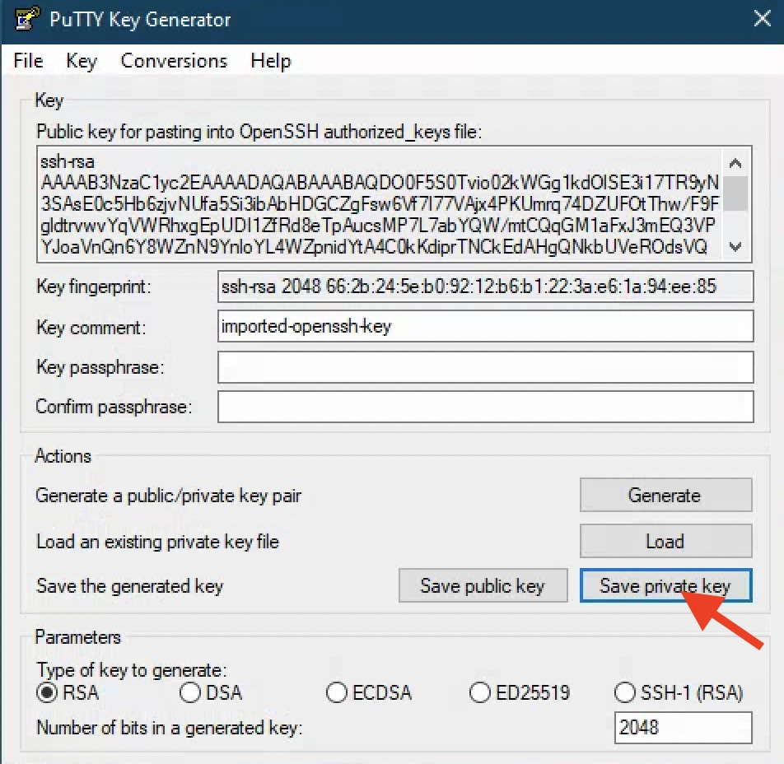
Convert pem to ppk

Slide 34
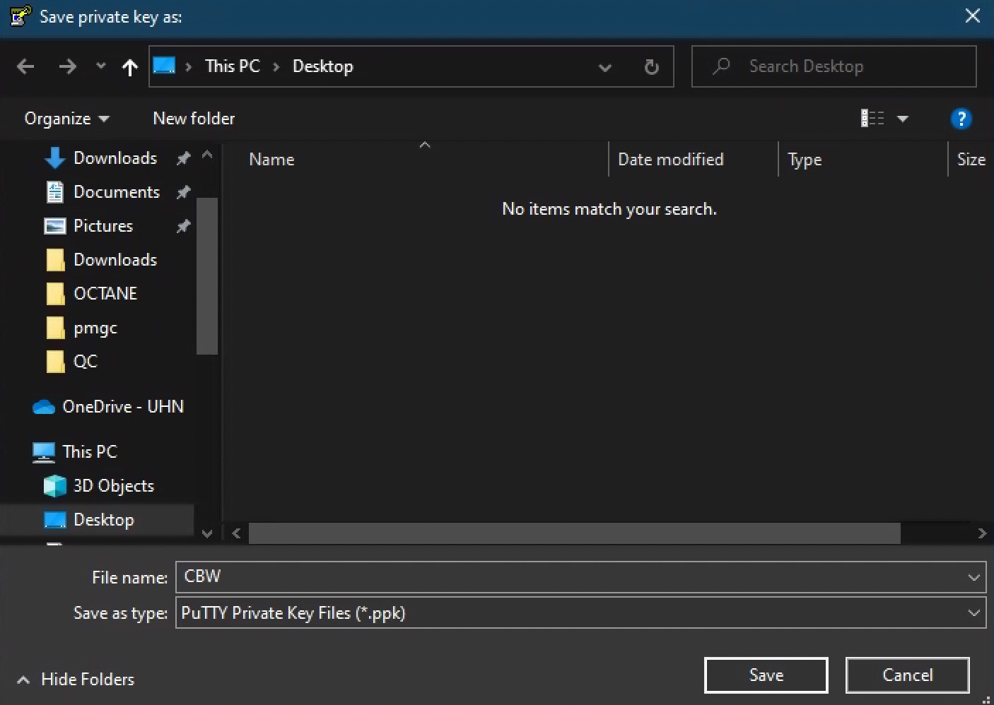
Convert pem to ppk

Slide 35
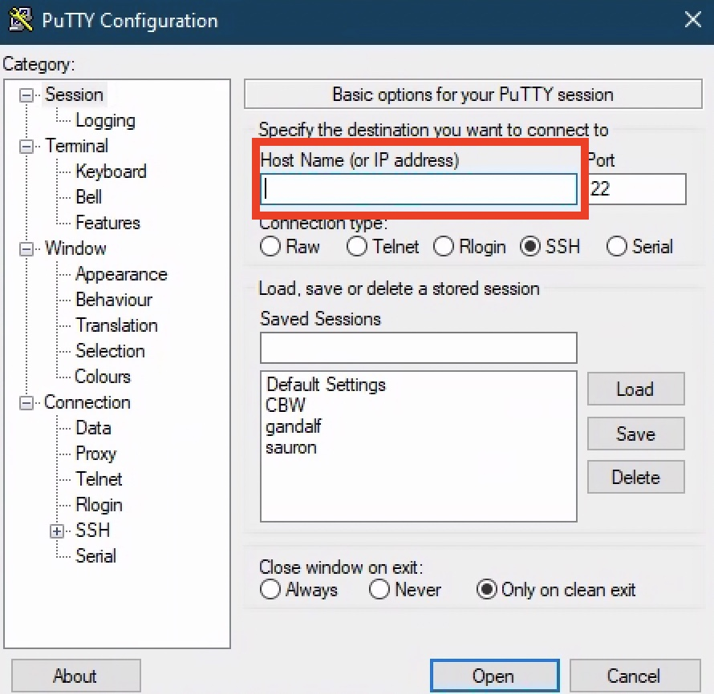
Use IPv4 or Ipv4 DNS

Slide 36
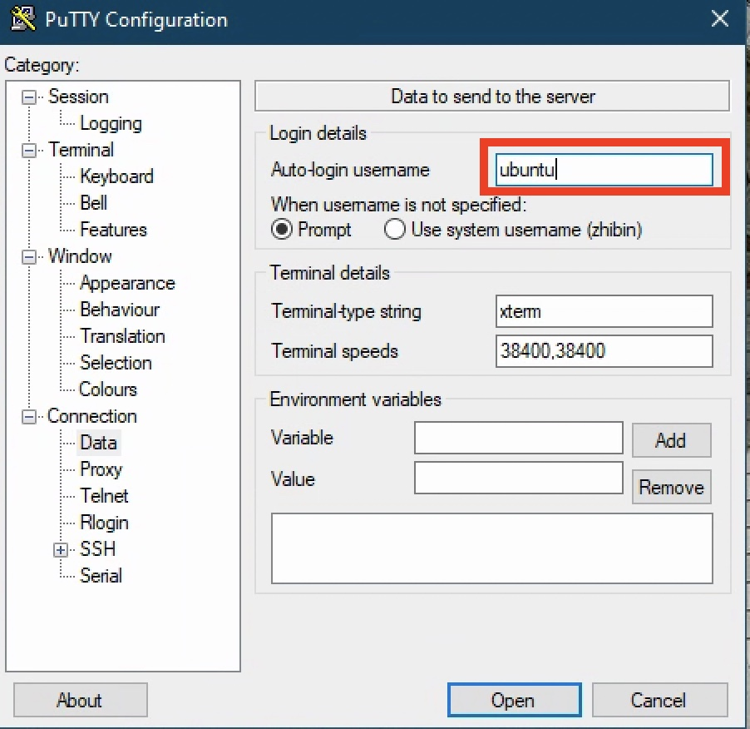
Use “ubuntu” as the username

Slide 37
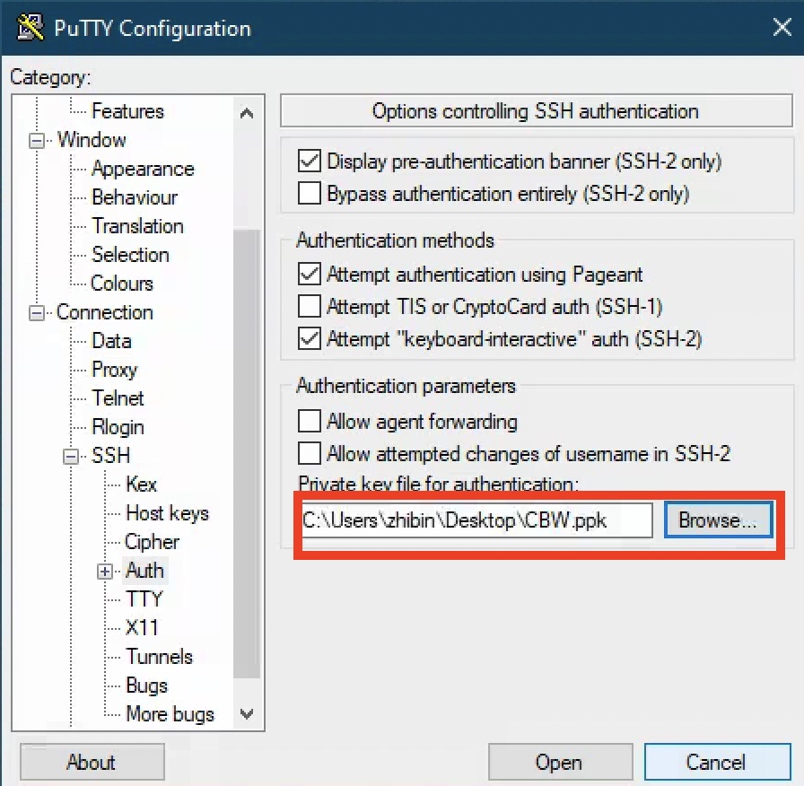
Use the converted ppk file as the private key

Slide 38
Nothing is free!
You pay storage, instance, data transfer, … with your credit
Stop your instance when you finish and will need it later.
Terminate your instance if you will not use it anymore.

Slide 39




We are on a Break
Workshop Sponsors:

